Slide 1
IPHIS: IMMUTABLE PERSONAL HEALTH INFORMATION SYSTEM UML
Presented By: Rahul A.Gidde
Created Date: 1-08-2018
Sponsored By:ReyGlobal,India.

Slide 2
What is the UML?
UML stands for Unified Modeling Language.
Standard language for specifying, visualizing, documenting and constructing the artifacts of a software-intensive system.
Not a programming language but there are tools that can be used to generate code in various languages using UML diagrams.
UML has a direct relation with object-oriented analysis and design.

Slide 3
UML Usage:
The UML may be used to:
Represent the Elements of a system or a domain and their relationships in a static structure using class and object diagrams.
Model the Behavior of objects with state transition diagrams.
Reveal the physical implementation architecture with component & deployment diagrams.
Display the boundary of a system & its major functions using use cases and actors.

Slide 4
UML: Basic Types
Modeling elements
Relationships
Diagrams

Slide 5
Modeling Elements :
Structural elements
type, class, instance, collaboration, use case, component, node.
Behavioral elements
interaction, state machine
Grouping elements
package, subsystem

Slide 6
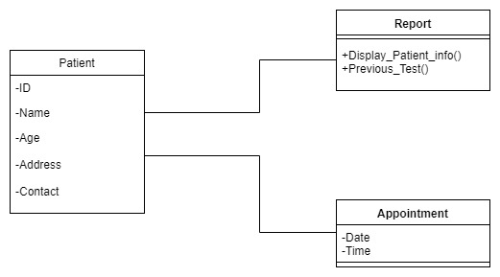
Classes and Instances
Specifications for one or more distinct objects with a common form (structure and behavior)

Slide 7
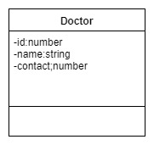
Attributes
The data/static structure aspect of a class is represented by its attributes
Attributes may be found by examining class definitions, the problem requirements, and by applying domain knowledge
Notes:
27

Slide 8
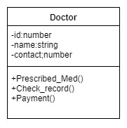
Operations
The behavior of a class is represented by its operations
Operations may be found by examining interaction diagrams
Notes:
26

Slide 9
Relationships
Relationships provide a pathway for communication between objects.
Types of relationship:
Association
Dependency
Aggregation
Generalization
Notes:
29

Slide 10
Types of Relationships:
Association :
An association is a bi-directional connection between classes
An association is shown as a line connecting the related classes
Aggregation:
An aggregation is a stronger form of relationship where the relationship is between a whole and its parts.
An aggregation is shown as a line connecting the related classes with a diamond next to the class representing the whole
Dependency:
A dependency relationship is a weaker form of relationship showing a relationship between a client and a supplier where the client does not have semantic knowledge of the supplier.
Notes:
30

Slide 11
Generalization (Inheritance)
A generalization is a relationship between a more general and a more specific element
Inheritance is the main property of generalization-specialization relationships defined between a superclass and its subclasses
Common attributes, operations, and/or relationships are shown at the highest applicable level in the hierarchy.
Notes:
35

Slide 12
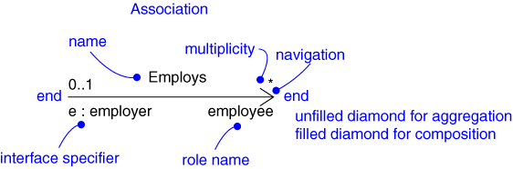
Relationships: Notation
Association
Dependency
Aggregation
Generalization
Realization
Client
name
Supplier
Part
Aggregate
Superclass
Subclass
type
Implementation
class

Slide 13
UML Model Views
Requirements (use case diagrams)
Static structure (class diagrams)kinds of objects and their relationships
Dynamic behavior (state machines)
possible life histories of an object
Interactive behavior (activity, sequence, and collaboration diagrams)
flow of control among objects to achieve system-level behavior
Physical implementation structures (component and deployment diagrams)
software modules and deployment on physical nodes

Slide 14
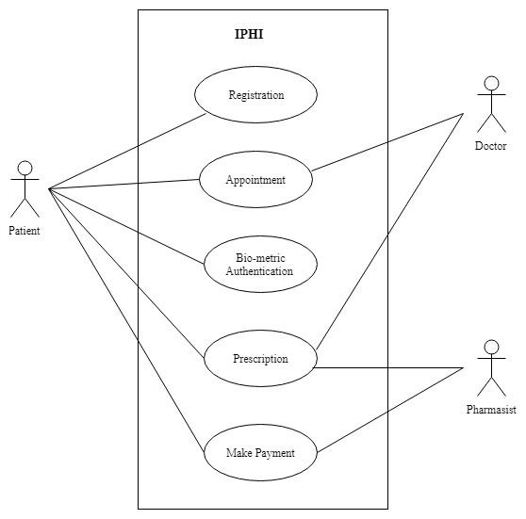
Use Case Diagram:
In UML Use Case Diagrams referred to as behavior diagrams used to describe a set of actions that some system can perform in collaboration with one or more external users of the system.

Slide 15
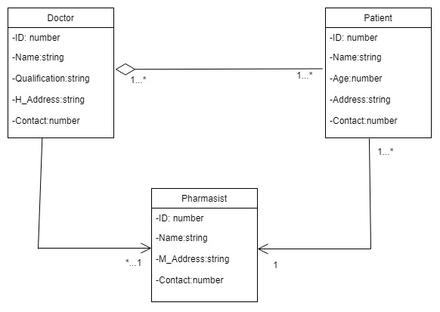
Class Diagram:
A class diagram in the uml is static structure diagram that describes the structure of the system by showing the system classes their attributes.

Slide 16
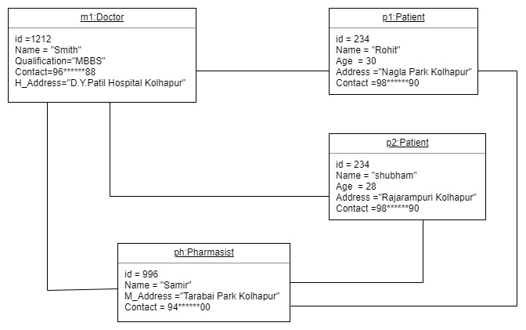
Object Diagram
Object diagram represent an instance of class diagram object diagram derived from class diagram so object diagrams are dependent upon class diagrams.

Slide 17
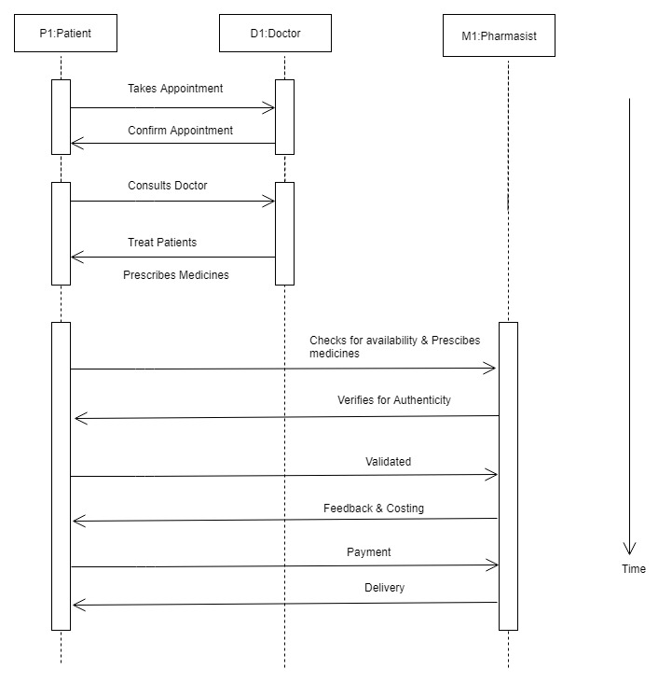
Sequence Diagram:

Slide 18
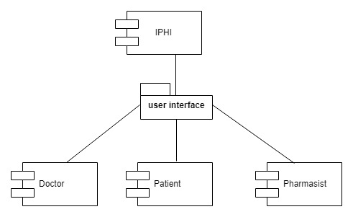
Component Diagram:

Slide 19
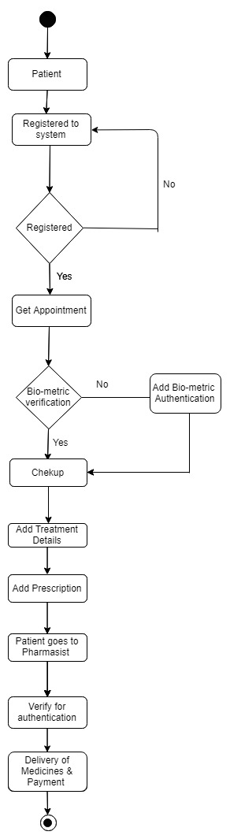
Activity Diagram:

